Slide 1
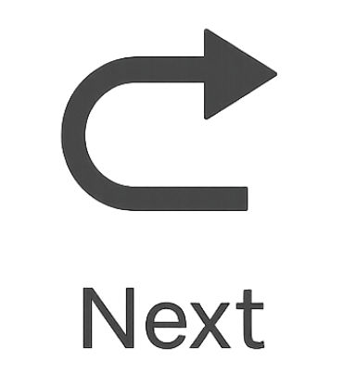

How to Read and Plot Points on a Coordinate Plane
A quick guide to mastering the coordinate plane!
Let’s learn how to identify, plot, and understand ordered pairs (x, y).
Click through each step and try the interactive quiz at the end!
Notes:
Narration: Welcome! Today we’re going to explore how to read and plot points on a coordinate plane. You’ll learn what each part represents and practice along the way.

Slide 2


Learning Goals
Understand the parts of a coordinate plane.
Read and interpret ordered pairs (x, y).
Plot points accurately in each quadrant.
Notes:
Narration: By the end of this lesson, you’ll be able to identify key parts of the coordinate plane, read ordered pairs, and plot points confidently.
Images created and edited in Canva

Slide 3
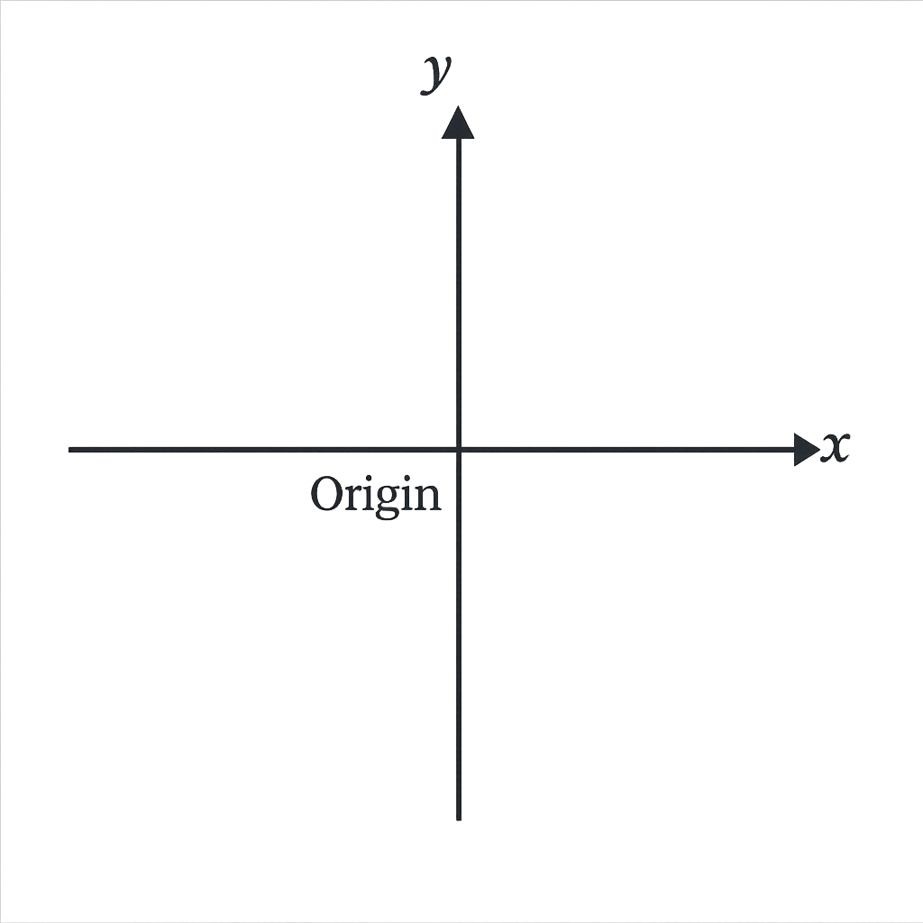
Figure 1: The coordinate plane with the x and y axes
Parts of the Coordinate Plane
Horizontal axis = X-axis (left ↔ right).
Vertical axis = Y-axis (up ↕ down).
The point (0, 0) is called the Origin.
The axes divide the plane into 4 quadrants.
Figure 2: The origin is located at (0,0)
Notes:
Narration: The coordinate plane has two main axes — the x-axis and the y-axis. They meet at the origin, and together they divide the plane into four quadrants.
Images edited in Canva: made axes and axes label and “origin”

Slide 4
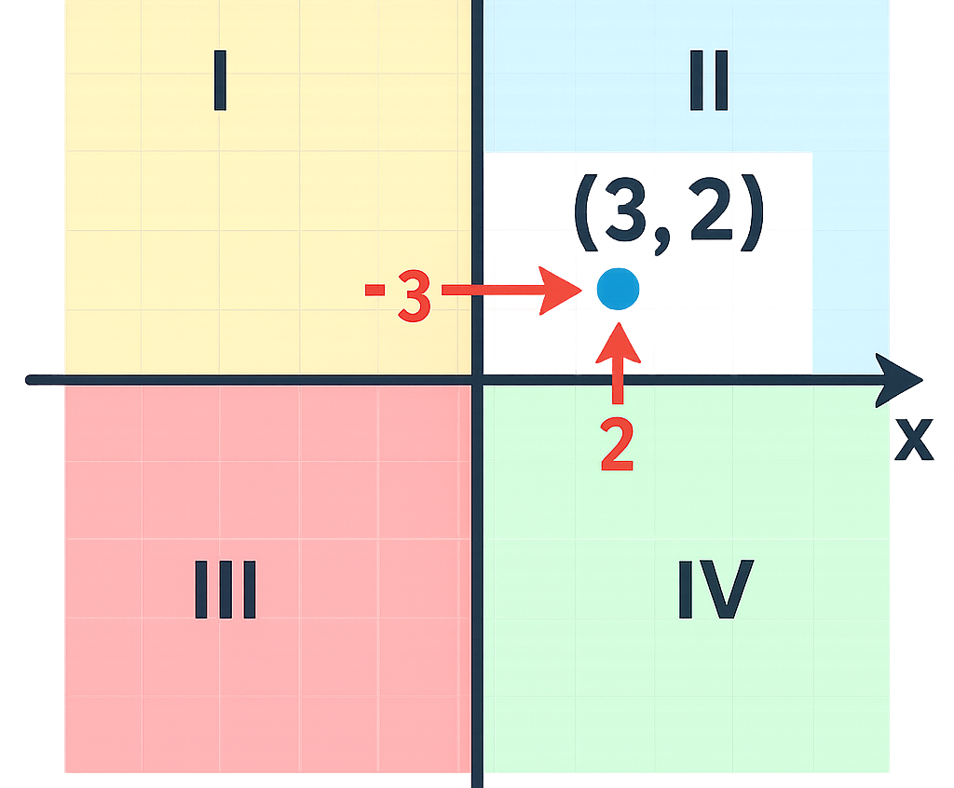
Understanding Ordered Pairs (x, y)
Each point is written as (x, y).
X = horizontal movement from origin.
Y = vertical movement from origin.
Always move along X first, then Y.
Notes:
Narration: Each coordinate tells you how far to move right or left along the x-axis and then up or down along the y-axis.
Images created and edited in Canva: added labels, grid, and color-coded quadrants

Slide 5
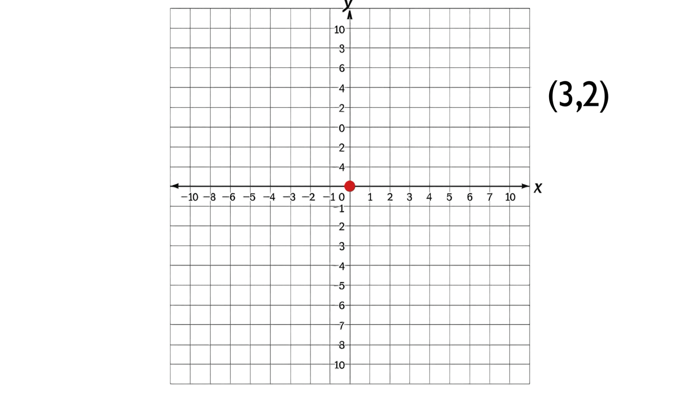
Plotting Points Example 1: Positive Coordinates
Example: (3, 2)
Start at Origin (0, 0).
Move 3 units right (x = 3).
Move 2 units up (y = 2).
Mark the point (3, 2).
Notes:
Let’s plot our first example point: (3, 2). Start at the origin — that’s the point (0, 0) where the x-axis and y-axis meet. Now move three units to the right along the x-axis. From there, move two units up along the y-axis. That’s your plotted point — (3, 2) — in Quadrant I
Images created in Canva. Animation (mp4) created and edited in Canva

Slide 6
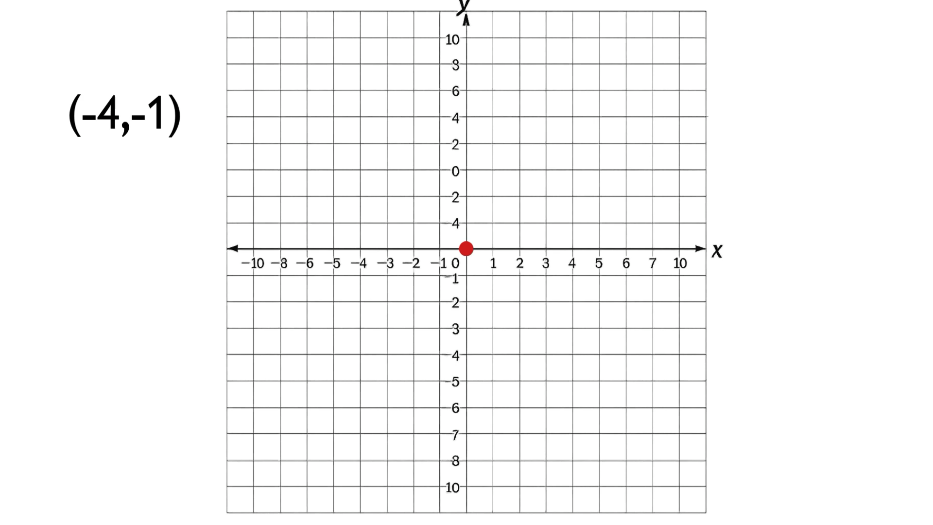
Plotting Points Example 2: Negative Coordinates
Example: (-4, -1)
Start at Origin (0, 0).
Move 4 units left (x = -4).
Move 1 unit down (y = -1).
Mark the point (-4, -1).
Notes:
Narration: Negative coordinates go left or down. From the origin, move left four and down one for point (-4, -1).
Images created and edited in Canva. Animation (mp4) created and edited in Canva

Slide 7
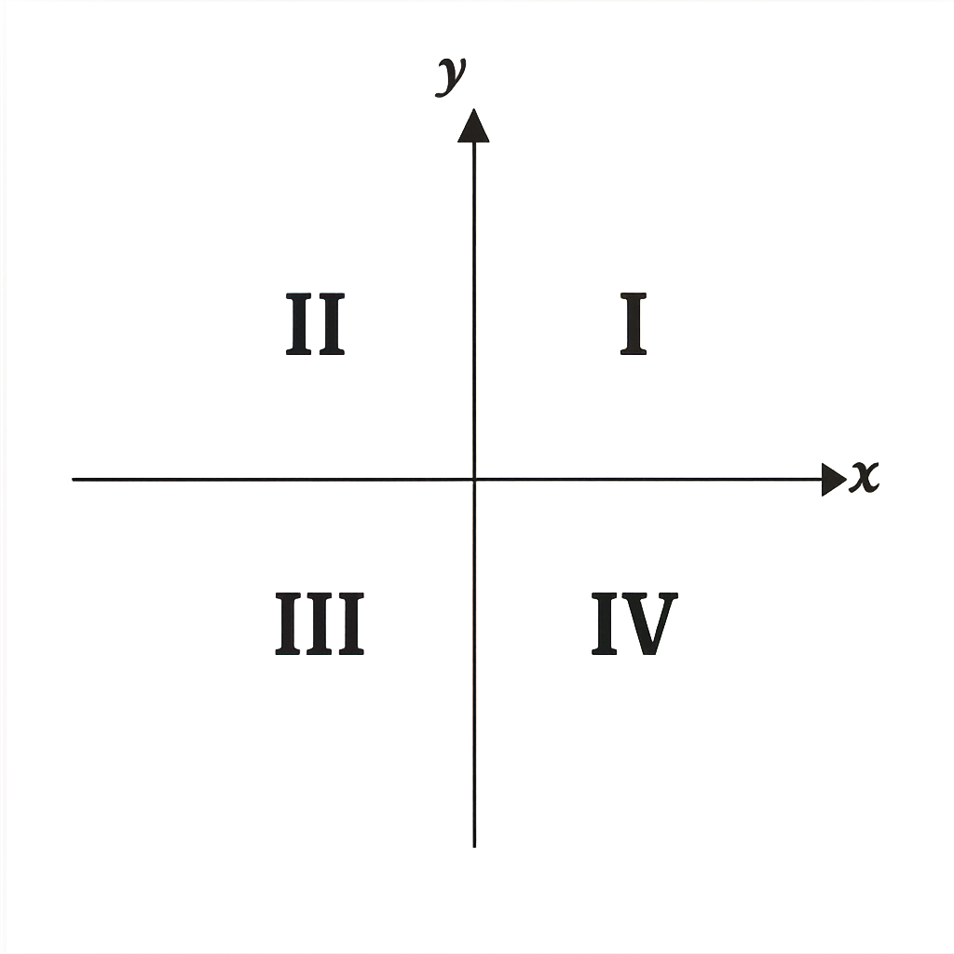
Quadrants Overview
Quadrant I (+, +)
Quadrant II (-, +)
Quadrant III (-, -)
Quadrant IV (+, -)
Each point belongs to one quadrant.
Notes:
Narration: The coordinate plane has four quadrants. The top right is Quadrant I, and they go counterclockwise from there.
Images created and edited in Canva

Slide 8
Mini Quiz: Let’s Test Your Skills!
Click the correct quadrant number for the point (-4, 3):
Quadrant I
Quadrant II
Quadrant III
Quadrant IV
Notes:
Narration: Let’s see what you’ve learned! Which quadrant would the point (-4, 3) appear in? Click your answer.
Images created and edited in Canva (including Roman Numerals).

Slide 9
Correct Answer!
✅ Yes! (-4, 3) is in Quadrant II because X is negative and Y is positive.
Great job! Click below to move to the final review.
Notes:
Narration: Well done! Since x is negative and y is positive, the point belongs in Quadrant II. If you did not get that correct, there are some options to practice more in our final slide.
Emoji used via text. Image created and edited in Canva

Slide 10
Closing & Next Steps
🎯 Review: X-axis, Y-axis, Origin, Quadrants.
Practice plotting points at home.
Try interactive tools below:
Desmos Graphing Practice
MathGames
For information/questions please contact me via the link below:
Email Contact
All visuals created and edited using tools in Canva and PowerPoint
Notes:
Narration: Great work! Now that you understand the coordinate plane, keep practicing with these online tools to sharpen your skills.
All visuals created and edited by author using tools and stock images in Canva and PowerPoint.

